Slide 1
2025 My Cash Flow in Sequence Review
If you decide to sign up with Sequence based on this review, please use this link as we each will receive $25.
My review based on ONE year of use.
Cave Arnold – Software engineer, CFP, RICP
Cavearnold@gmail.com
Notes:
35 years working in a corporate career
Retired November 2023
Problem Statement

Slide 2
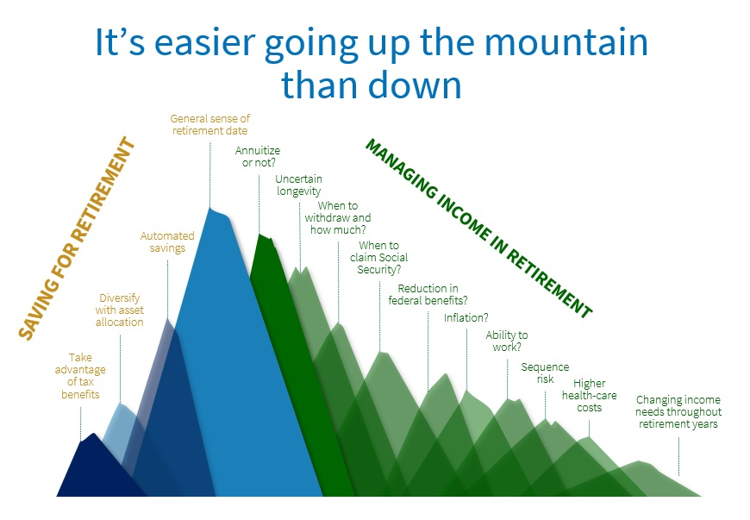
What is the general problem?
?
Notes:
I really like the analogy of preretirement accumulation and post retirement decumulation as climbing a mountain and afterward descending.
Different tools and skills are required in each case.
When I was accumulating almost everything was automated: savings, investment, tax withholding.
The biggest shock for me and many retirees like me is the loss of a regular Paycheck.

Slide 3
What is the specific problem?
?
While working I had a regular paycheck from which 401(k), Federal, State and Local Taxes, Healthcare and Charitable giving were withheld.
The residual was direct deposited into my savings account and a portion was invested in a brokerage account, two Roth IRAs and funding two 529 accounts.
Once or twice a month I would transfer from savings to checking to cover all my spending and liabilities.
This would fail at times as life was distracting and spending lumpy so I kept ~ 3 to 5 months spending in my savings and had overdraft protection setup as insurance.
Once I retired there was no paycheck and so I looked for a way to create and automate a replacement.
This is where Sequence comes in to replace and improve upon my previous working paycheck cash flow scheme.

Slide 4
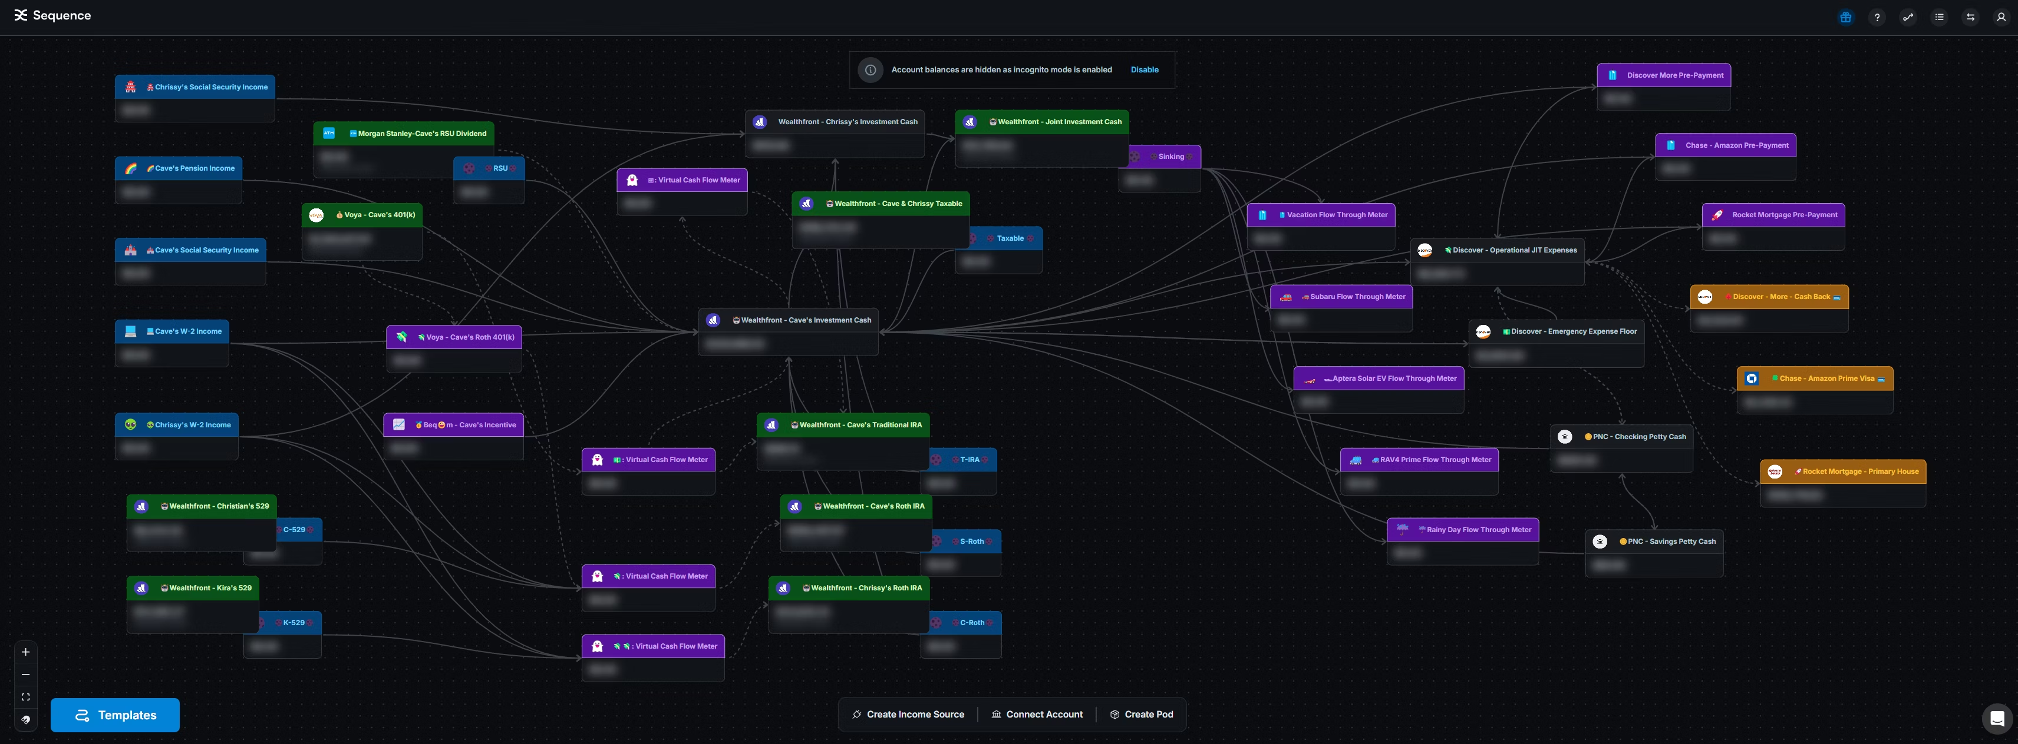
My Sequence Cash Flow
→
Notes:
Key – Blue are Income Sources – Paycheck Green are Investments – 401(k), IRA, 529
Purple are Sequence Virtual Depository Accounts – Savings
Grey are Depository accounts – Checking or Savings
Orange are liabilities – Credit Cards or Mortgage
Flow is from Left to Right: Income to Liability payment.
I will talk about each financial zone in more detail in later slides.

Slide 5
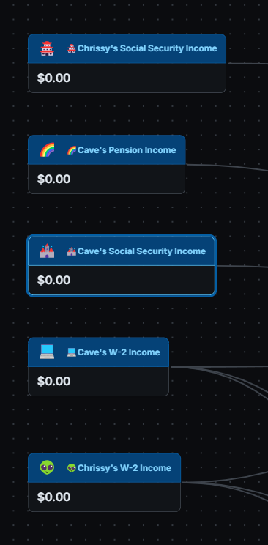
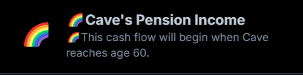

W-2 Income Streams
→
In addition to automating my cash flows I use Sequence to document them visually and by using description fields to annotate accounts and rules.
Notes:
Self Documenting Cash Flows

Slide 6
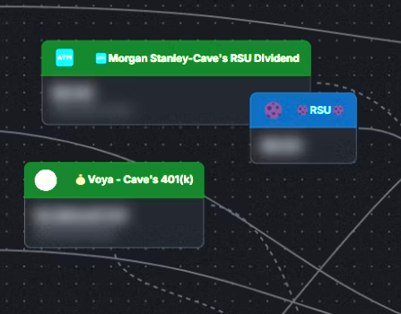
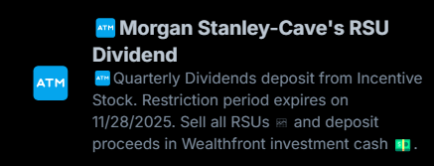
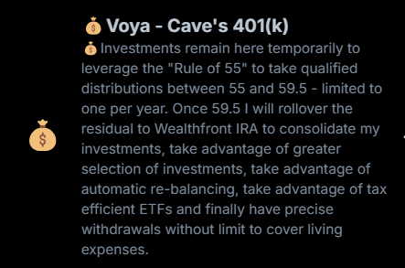
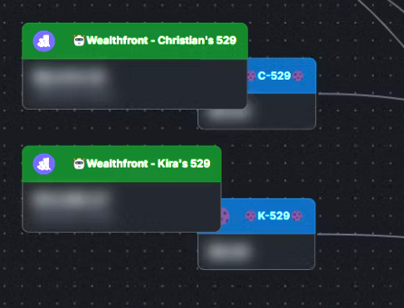
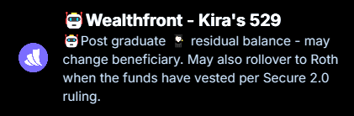
Asset Based Income Streams
→
The blue Income Sources are used where outbound transfers are not allowed.
They are used for inbound transfers once assets are liquidated.

Slide 7
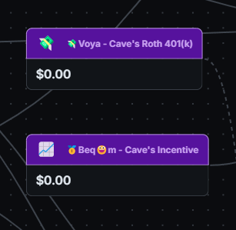
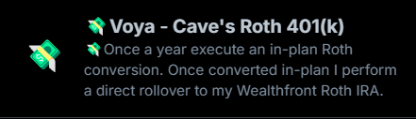
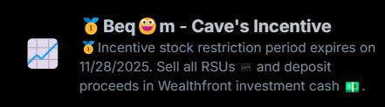
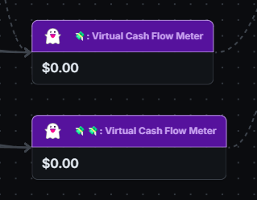
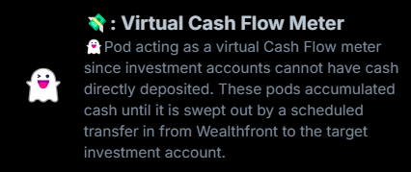
Asset Based Income Transfers
→
There are some internally held accounts that are not accessible and must be represented as manual entries.
There are many investment accounts that do not support direct deposits.
I am using virtual pass-through accounts in Sequence for these.
I have these linked to the associated investment system to be swept out by schedule.

Slide 8
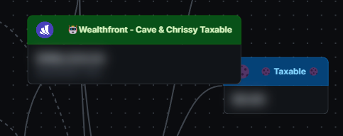
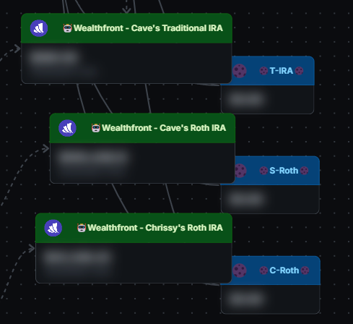
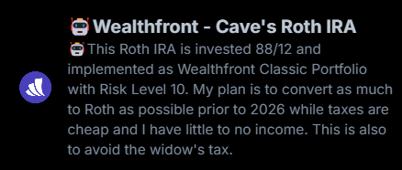
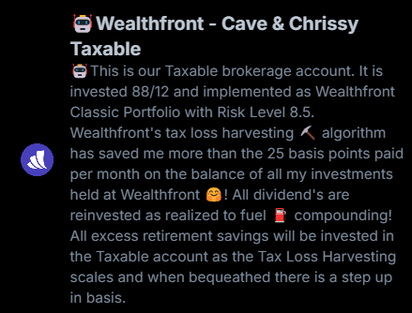
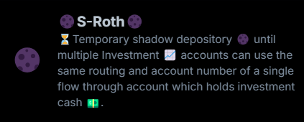
Long Term Assets
→

Slide 9
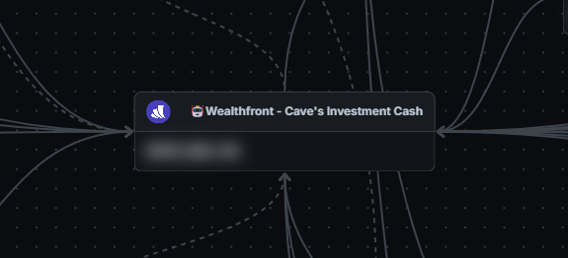
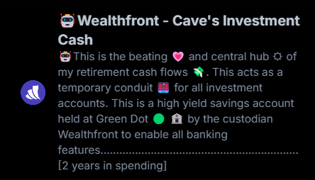
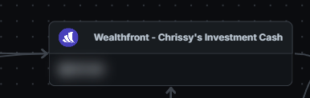
Cash Investment Buffer
→

Slide 10
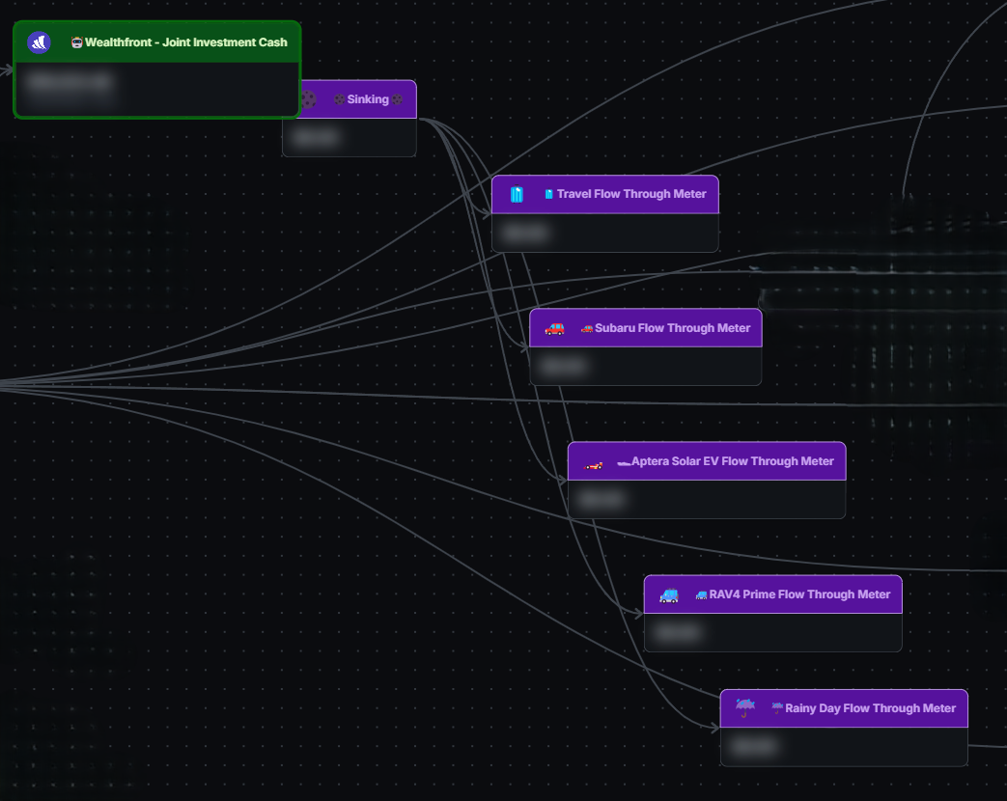
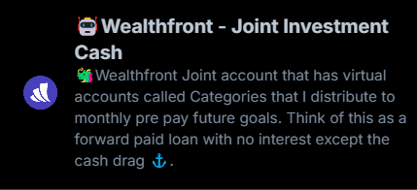
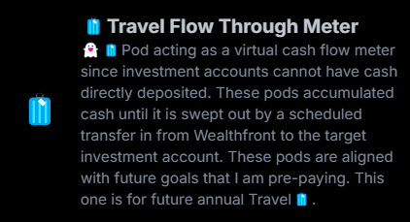
Joint Cash and Sinking Funds
→

Slide 11
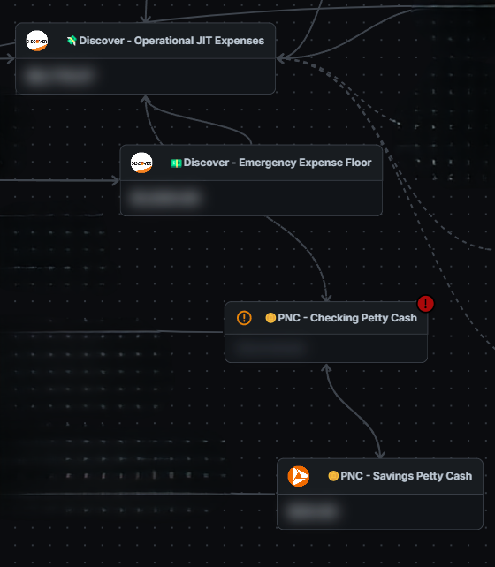
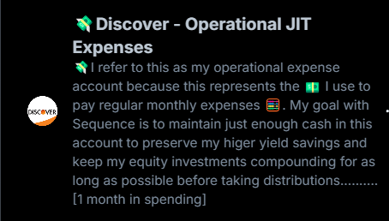
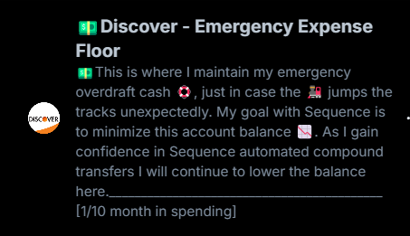
Operational Banking
→

Slide 12
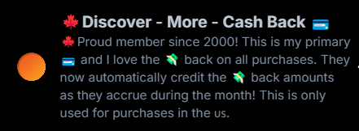
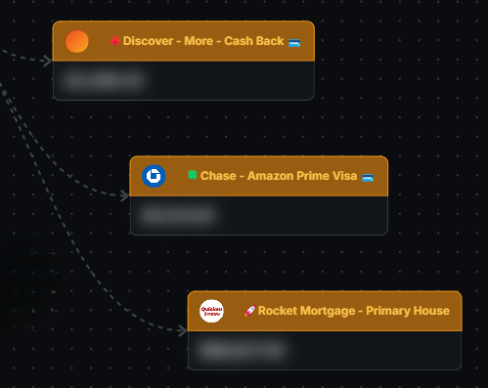
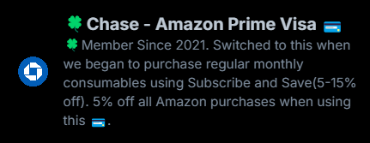
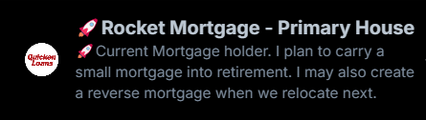
Liabilities
→

Slide 13
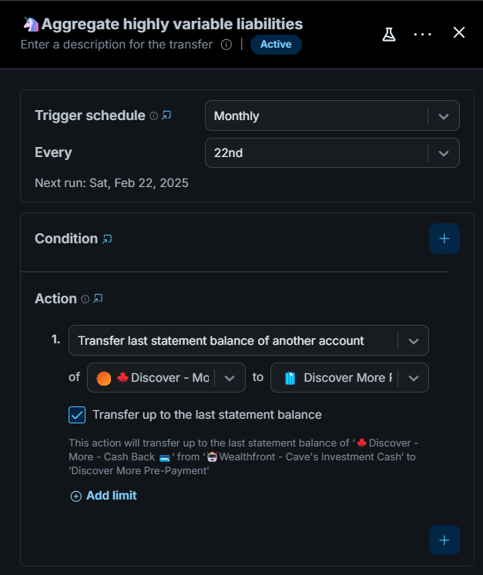
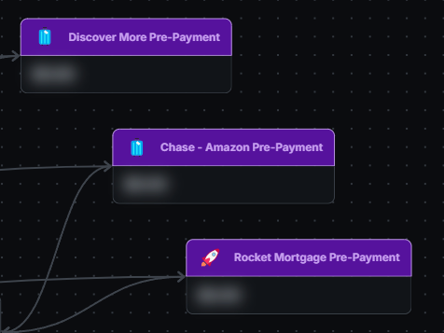
Liability Pre-Staged Payments
→

Slide 14
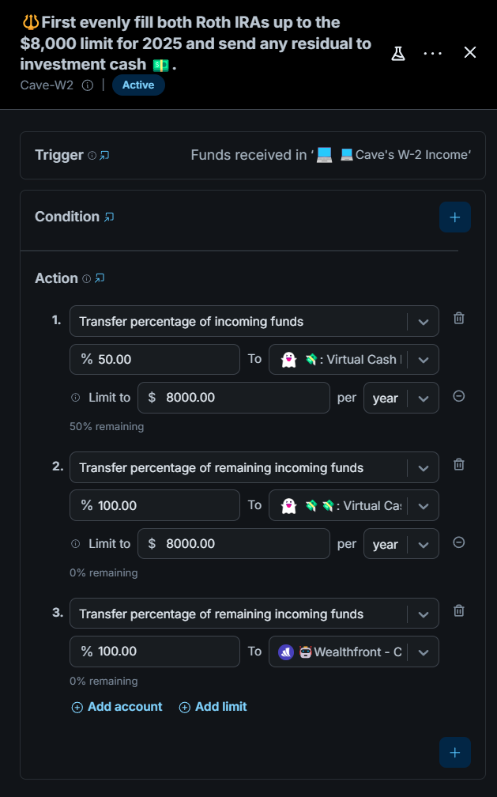
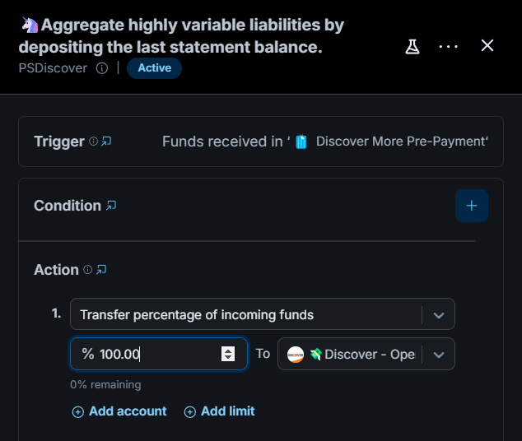
ACH Naming with Rules
→

Slide 15
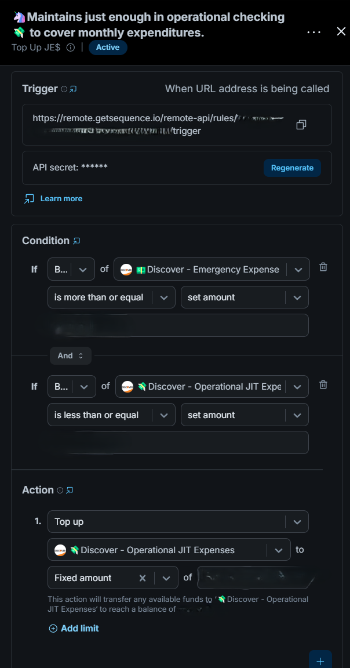
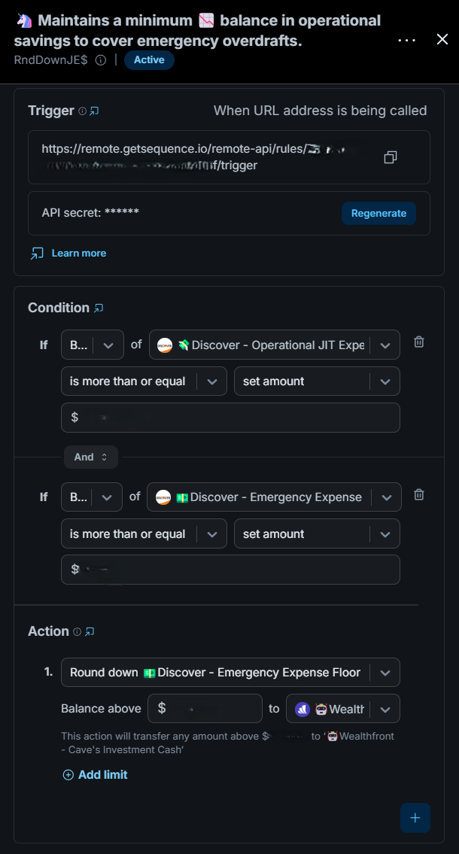
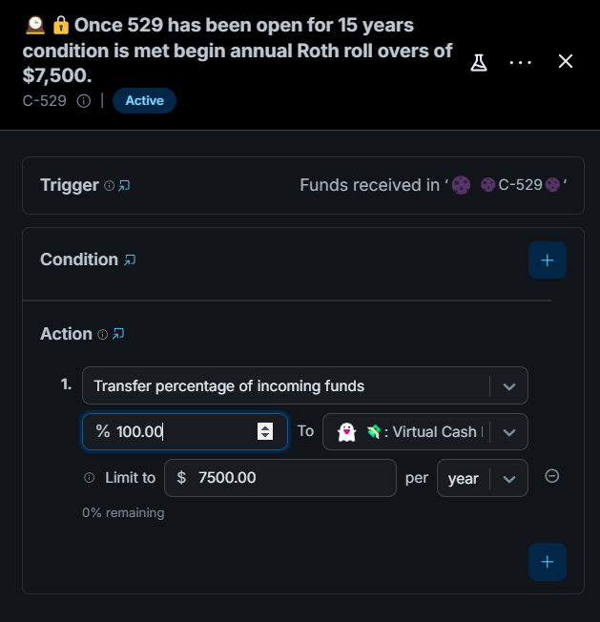
Rule Flexibility Examples
→

Slide 16
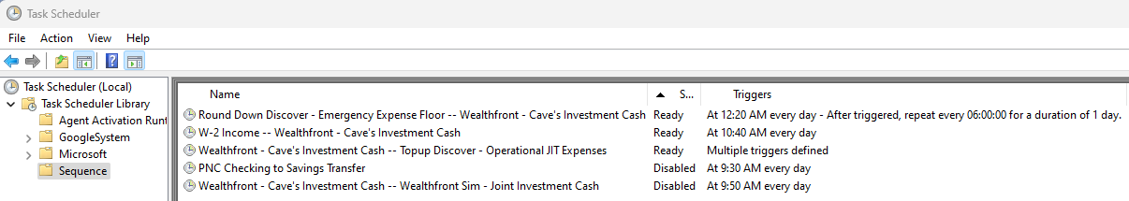
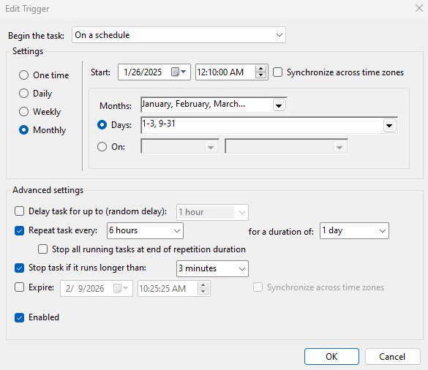
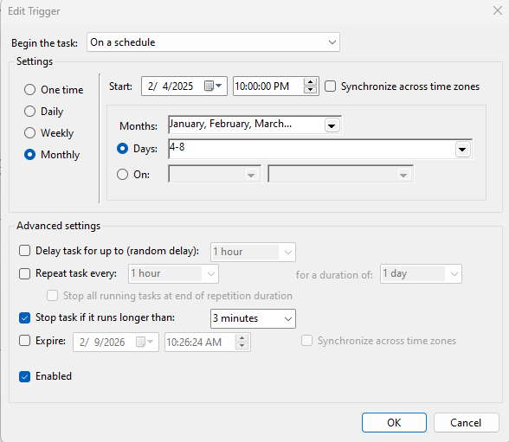
Sequence Rule Schedule
*
Sequence internal scheduling was not flexible enough for all my needs.
I coded a console application in C# that calls a Sequence RESTful trigger endpoint.
This allows me to create complicated split schedules for different portions of the month.

Slide 17
Bonus Material
*

Slide 18
My Retirement Financial Application Stack
*
Planning – Primary: Income Lab, Secondary for consensus: New Retirement, Money Guide Pro Elite and Wealthfront’s Path.
Tracking – Quicken.
Automation – Sequence and SequenceAPITest.
Decision Tools – Guyton Klinger Withdrawal Calculator and Withdrawal Timing.
Community – The Rock Retirement Club.

Slide 19
My Retirement Financial Research Stack
*
Research – In each category I list the three most helpful sources.
Books – A Random Walk Down Wall Street, Retirement Planning Guidebook and How to Retire
Sites – Morningstar, Kitces and Retirement Researcher
YouTube – James Conole, CFP®, Peter Lazaroff and Income Lab
News Letters – OptimistiCallie, Of Dollars And Data and 6-Shot Saturday

